Slide 1

Presented by: Aryan Mishra
Arvind Gautam
Garvit Singhal
Shreyash Srivastava
Under the guidance of: Dr. Rekha Kashyap

Slide 2
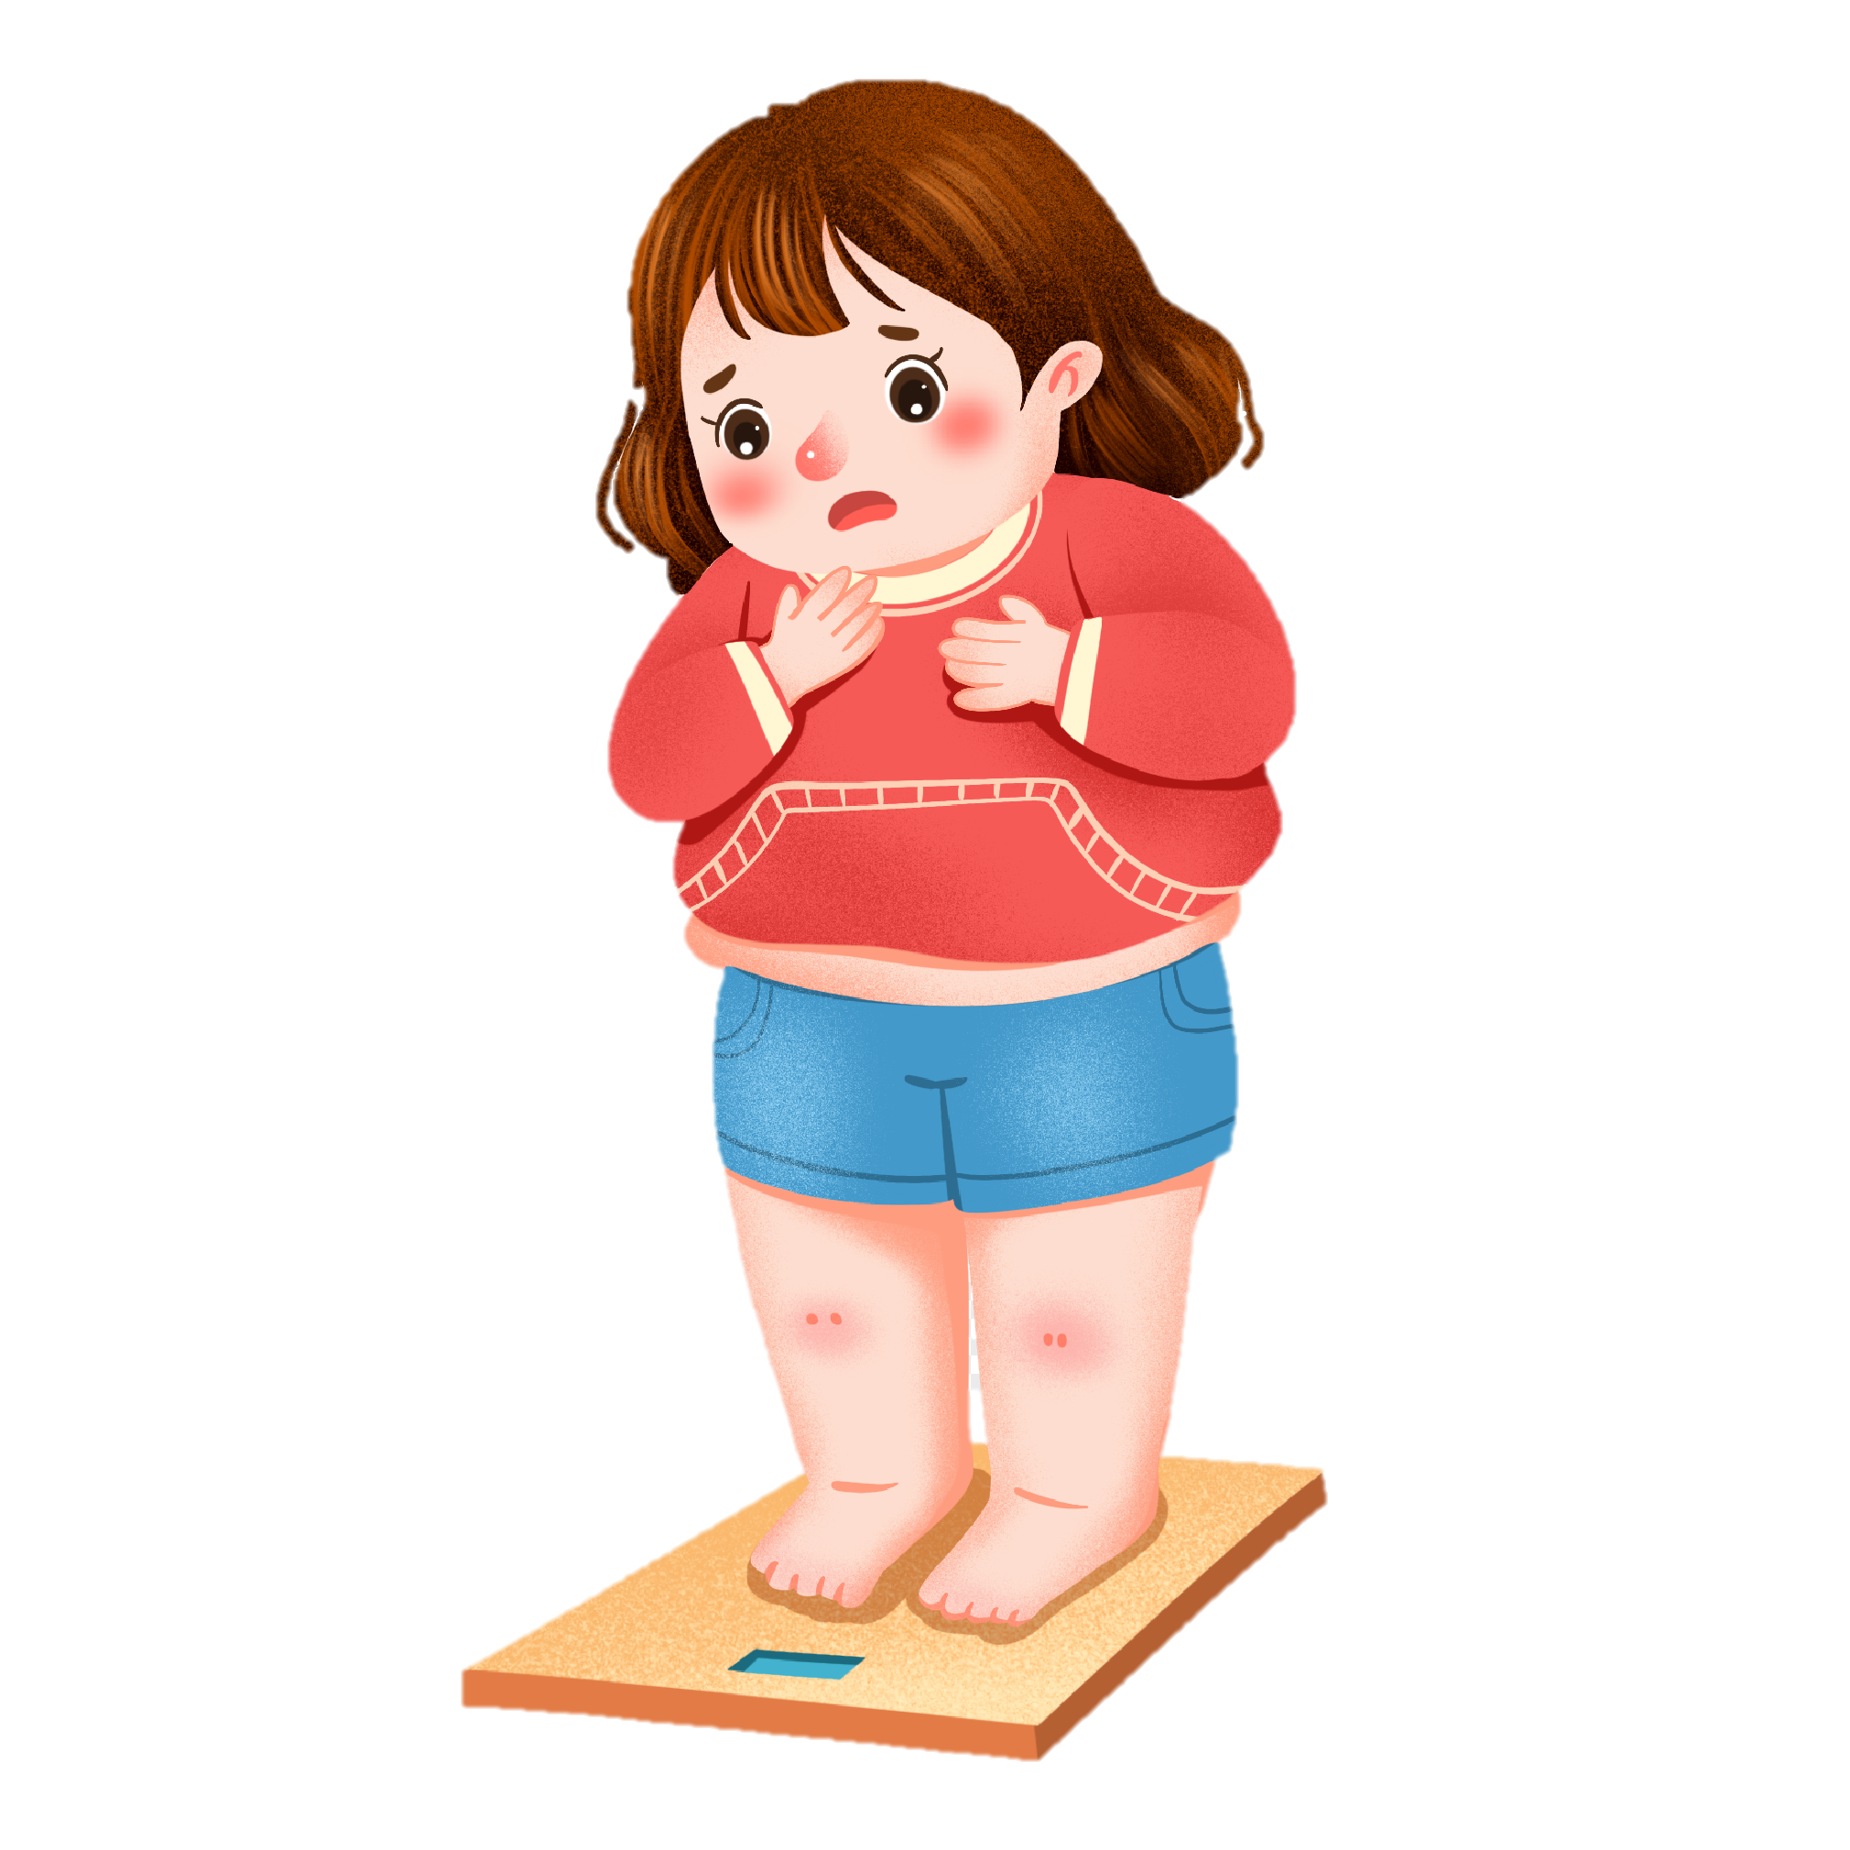
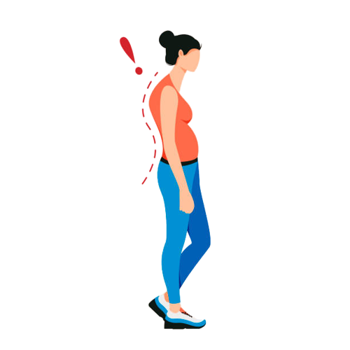
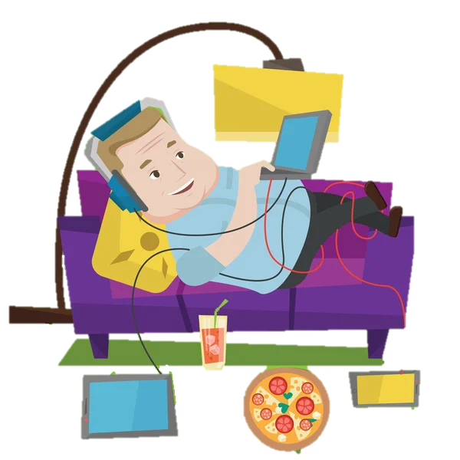

Problem Statement
Bad Posture
Injuries
Obesity
Unhealthy Lifestyle

Slide 3
Problem Statement
Bad Posture

Slide 4
Problem Statement
Injuries

Slide 5
Problem Statement
Obesity

Slide 6
Problem Statement
Unhealthy Lifestyle

Slide 7
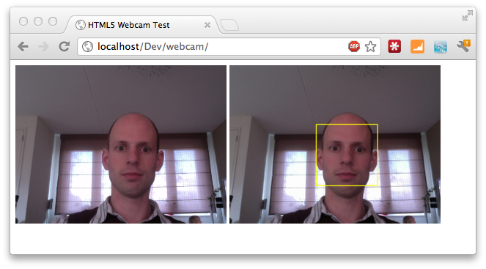
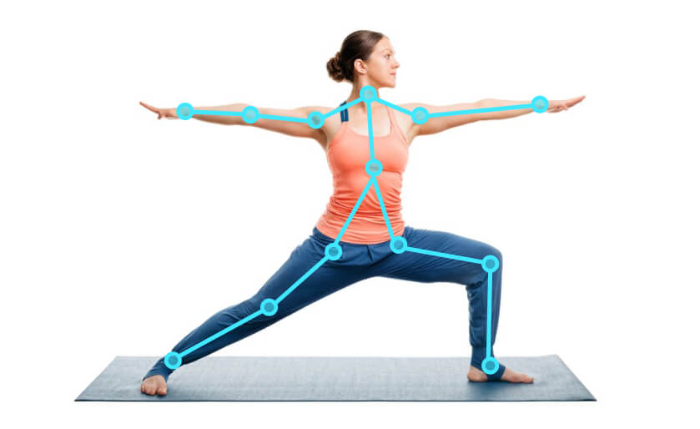

Solution : BlissFit
Web Cam Integration
Posture detection
Fitness Application

Slide 8
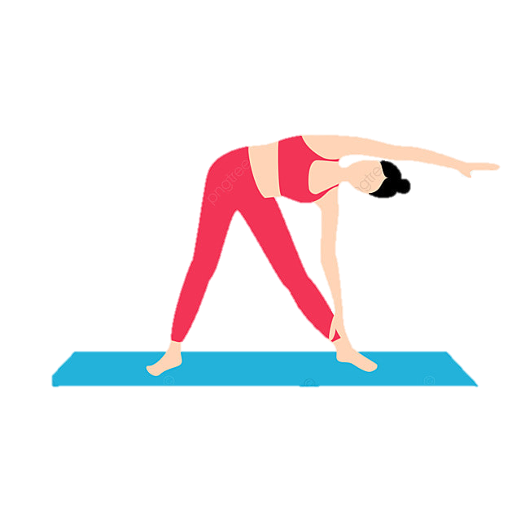


Features
Yoga Posture Checker
Workout Planner
Calorie Tracker

Slide 9
Features
Yoga Posture Checker

Slide 10
Features
Workout Planner

Slide 11
Features
Calorie Tracker

Slide 12

Functional Requirements

Slide 13


Posture Detection
Real-time webcam input
Integration of model to analyze the posture
Active feedback to the user

Slide 14



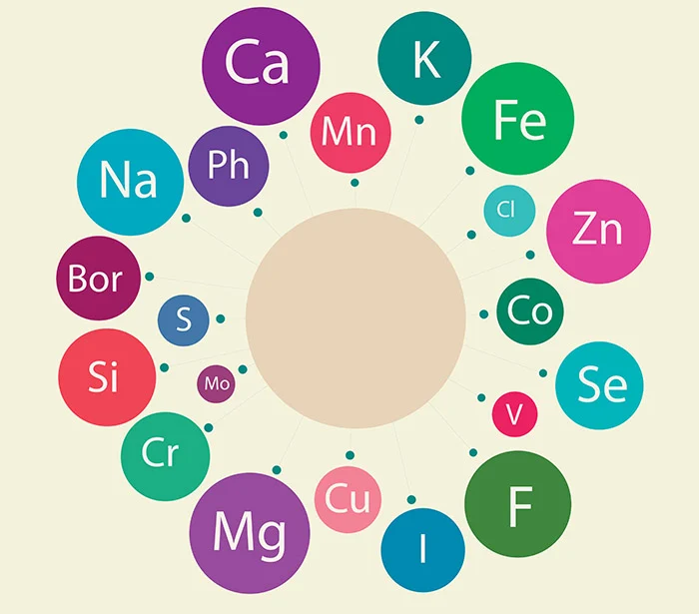
Calorie Tracking
Input daily food consumption.
Calculate and display the total calorie intake based on the input.
Provide a comprehensive food database.
Provide nutritional information for each food item.

Slide 15



Workout Planning
Pre-defined workout plans
Make custom workout plans
Daily reminder according to the plan

Slide 16




TECHNOLOGIES USED

Slide 17
Implementation Status
Data Collection
Data Cleaning
Feature Extraction
Data Splitting
Model Imposition
Integration with webcam
Posture Check

Slide 18
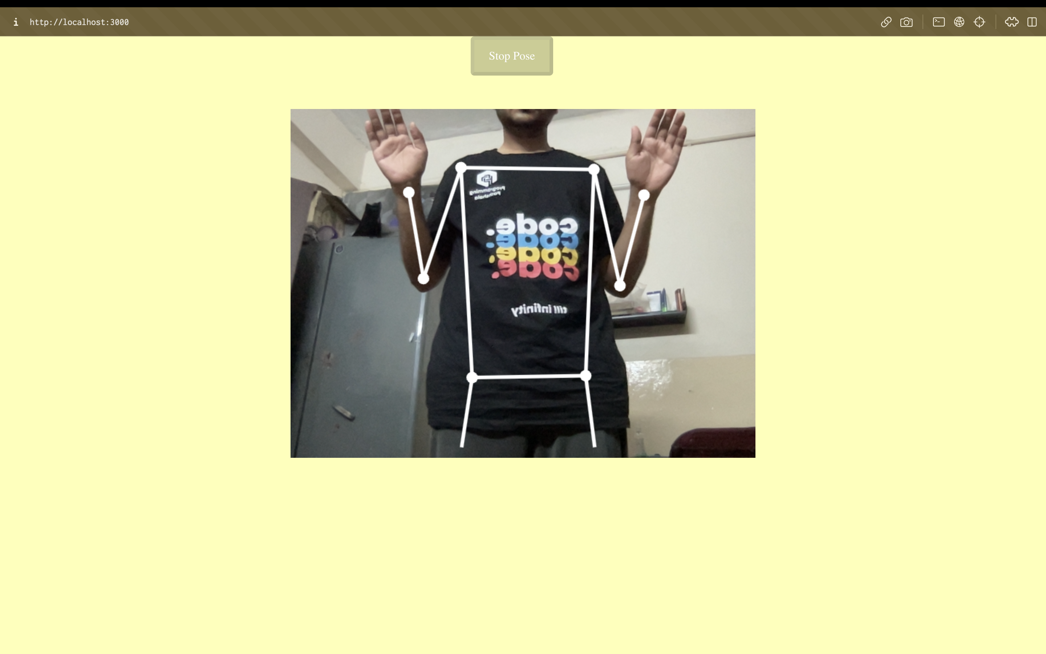
Contd.

Slide 19
Thank You!

